Slide 1
Introduction to Data Mining
By Dr. Sambit Satpathy

Slide 2
Today Class Discussion
Syllabus
Whole semester Plan
Paid internship and project work

Slide 3
1. Syllabus (Module 1)
Introduction: What Is Data Mining? Data Mining and Related Terms, Knowledge based System, KDD Process Model, CRISP - DM, Terminology and Notation.
The Steps in Data Mining: Data Preparation, Data Understanding, Data Cleaning, Missing data, Coding Systems, Discretization, Univariate Data Analysis.
Data and its Exploration: Types of Data, Types of Data Sets, Outliers, Measures of Similarity,
Frequencies and the Mode, Measures of Location: Mean and Median, Measures of Spread: Range and Variance, Multivariate Summary Statistics.

Slide 4
1. Syllabus (Module 1)
Unsupervised Learning Models: Association Rules: Introduction, Discovering Association Rules in Transaction, Databases, Generating Candidate Rules, Selecting Strong Rules
Data Visualization: Uses of Data Visualization, Basic Charts: bar charts, line graphs, and
scatterplots, Boxplots and Histograms, Heat maps, Multidimensional Visualization, Specialized Visualizations, Summary of major visualizations and operations
Supervised Learning Models and Techniques: The Naive Bayes Classifier
Conditional Probability, Applying the Full (Exact) Bayesian Classifier, Advantages and
Shortcomings
Classification : Introduction, Measures of Impurity, Evaluating, Classification Rules from Trees, Classification Trees for More Than Two Classes, Regression Trees

Slide 5
1. Syllabus (Module 2)
Logistic Regression: Model with a Single Predictor, Estimating the Logistic Model from Data, Interpreting Results in Terms of Odds, Evaluating Classification Performance, Variable Selection, Data Preprocessing, Model Interpretation.
Cluster Analysis: Introduction, Measuring Distance Between Two Records, Measuring Distance Between Two Clusters, Hierarchical (Agglomerative) Clustering, k-Means Algorithm.
Dimension Reduction: Introduction, Curse of Dimensionality, Correlation Analysis, Reducing the Number of Categories in Categorical Variables, Converting Categorical to Numerical Variable, PCA,

Slide 6
1. Syllabus (Module 2)
Time Series: Handling Time Series, Regression-Based Forecasting, Smoothing Methods
Artificial Neural Networks: Concept and Structure of a Neural Network, Fitting A Network to Data, Required User Input, Exploring The Relationship Between Predictors and Response, Advantages and Weaknesses of Neural Networks
Anomaly Detection: Causes of Anomalies, Approaches to Anomaly Detection, Issues,
Statistical Approaches, Proximity-Based Outlier Detection, Density-Based Outlier Detection, Clustering-Based Techniques.

Slide 7
Data Mining Process: Models, Process Steps & Challenges Involved
1) Data Cleaning.
2) Data Integration.
3) Data Reduction.
4) Data Transformation.
5) Data Mining.
6) Pattern Evaluation.
7) Knowledge Representation

Slide 8
Common projects
1) Fake news detection, Detecting Phishing website
2) Diabetes prediction, House price prediction, Detecting Parkinson’s disease
3) Anime recommendation system
4) Food Classification
5) Heart Disease Prediction
6) Fraud Detection in Monetary Transactions

Slide 9
Basic terminologies
Data mining engine is very essential to the data mining system. It consists of a set of functional modules that perform the following functions −
Characterization
Association and Correlation Analysis
Classification/ clustering
Prediction
Cluster analysis
Outlier analysis
Evolution analysis

Slide 10
Hungarian Institute of Cardiology. Budapest: Andras Janosi, M.D (UCI MACHINE LEARNING)
Attribute Information: -- Only 13 used
-- 1. #3 (age) ) -- 12. #44 (ca)
-- 2. #4 (sex) 13. #51 (thal)
-- 3. #9 (cp)
-- 4. #10 (trestbps)
-- 5. #12 (chol)
-- 6. #16 (fbs)
-- 7. #19 (restecg)
-- 8. #32 (thalach)
-- 9. #38 (exang)
-- 10. #40 (oldpeak)
-- 11. #41 (slope)

Slide 11
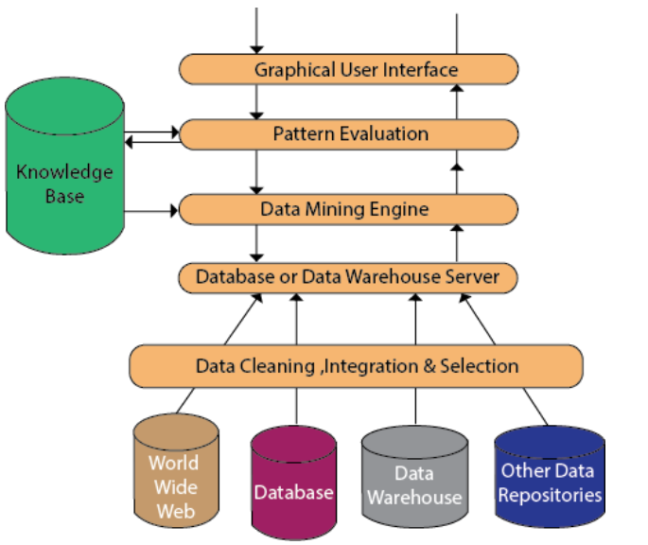
Data Mining Architecture

Slide 12
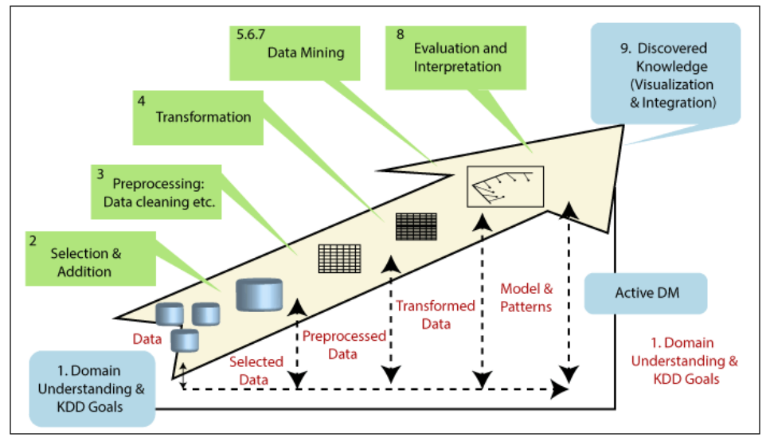
Knowledge Discovery in Databases (KDD) Model

Slide 13
Knowledge Discovery in Databases (KDD) Model
KDD represents Knowledge Discovery in Databases. It defines the broad process of discovering knowledge in data and emphasizes the high-level applications of definite data mining techniques.
1. Developing an understanding − This is the basic preliminary step. It creates the scene for learning what should be done with the several decisions like transformation, algorithms, representation, etc. The individuals who are in charge of a KDD venture are required to learn and characterize the goals of the end-user and the environment in which the knowledge discovery process will appear (involves relevant prior knowledge).

Slide 14
Knowledge Discovery in Databases (KDD) Model
2. Creating a target data set − It can be choosing a data set or targeting a subset of variables or data samples, on which discovery is to be implemented. This process is essential because Data Mining learns and finds from the accessible data. This is the evidence foundation for building the models. If some important attributes are missing, at that point, then the whole study can be unsuccessful from this respect, the more attributes are considered.
3. Data cleaning and pre-processing − Data cleaning defines to clean the data by filling in the missing values, smoothing noisy data, identifying and eliminating outliers, and removing inconsistencies in the data.

Slide 15
Knowledge Discovery in Databases (KDD) Model
4. Exploratory analysis and model and hypothesis selection − It can be selecting the data mining algorithm(s) and selecting method(s) to be used for searching for data patterns. This process contains deciding which models and parameters can be appropriate and matching a particular data-mining method with the long-term criteria of the KDD process.
5. Data mining − It is used to search for patterns of interest in a specific representational form or a set of such representations, involving classification rules or trees, regression, and clustering. The user can significantly help the data-mining method by correctly implementing the preceding steps.

Slide 16
Knowledge Discovery in Databases (KDD) Model
5. Acting on the discovered knowledge − It is using the knowledge directly, including the knowledge into another system for additional action, or simply documenting it and reporting it to interested parties. This process also contains checking for and resolving potential conflicts with previously accepted (or extracted) knowledge.

